Slide 1
EE-2003 Computer Organization & Assembly Language
INSTRUCTOR
Engr. Aashir Mahboob
Lecturer, Department of Computer Science
FAST NUCES (Karachi)
aashir.mahboob@nu.edu.pk

Slide 2
Chapter No: 03
ASSEMBLY LANGUAGE FUNDAMENTALS

Slide 3
INSTRUCTIONS
An instruction is a statement that becomes executable when a program is assembled.
Instructions are translated by the assembler into machine language bytes, which are loaded and executed by the CPU at runtime.
An instruction contains four basic parts:
Label (optional)
Instruction mnemonic (required)
Operand(s) (usually required)
Comment (optional)

Slide 4
INSTRUCTIONS
This is how the different parts are arranged:
[label:] mnemonic [operands] [;comment]
A label is an identifier that acts as a place marker for instructions and data.
It implies the address of instruction or variable.
A data label identifies the location of a variable, providing a convenient way to reference the variable in code.
Example
count DWORD 100
array DWORD 1024, 2048

Slide 5


INSTRUCTIONS
A label in the code area of a program (where instructions are located) must end with a colon (:) character.
. Code labels are used as targets of jumping and looping instructions.
Example
A code label can share the same line with an instruction, or it can be on a line by itself:

Slide 6
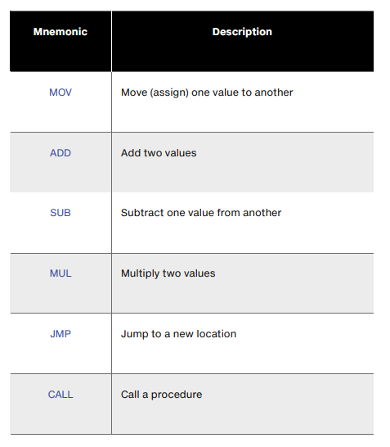
Instruction Mnemonic
An instruction mnemonic is a short word that identifies an instruction.
It provide hints about the type of operation they perform.

Slide 7
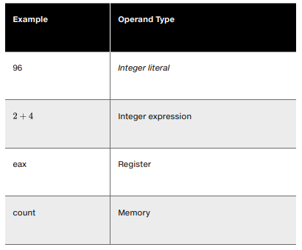
Operands
An operand is a value that is used for input or output for an instruction.
Assembly language instructions can have between zero and three operands.
Each of which can be a register, memory operand, integer expression, or input–output port.

Slide 8
Instruction Format Examples
No operands
– stc ; set Carry flag
One operand
– inc eax ; register
– inc myByte ; memory
Two operands
– add ebx,ecx ; register, register
– sub myByte,25 ; memory, constant
– add eax,36 * 25 ; register, constant-expression

Slide 9
Instruction Format Examples
Three operands
- imul eax, ebx, 5
There is a natural ordering of operands.
When instructions have multiple operands, the first one is typically called the destination operand.
The second operand is usually called the source operand.
In general, the contents of the destination operand are modified by the instruction.

Slide 10

The NOP (No Operation) Instruction
The safest (and the most useless) instruction is NOP (no operation).
It takes up 1 byte of program storage and doesn’t do any work.
It is sometimes used by compilers and assemblers to align code to efficient address boundaries.
In the following example, the first MOV instruction generates three machine code bytes.
The NOP instruction aligns the address of the third instruction to a doubleword boundary (even multiple of 4):
x86 processors are designed to load code and data more quickly from even doubleword addresses.

Slide 11
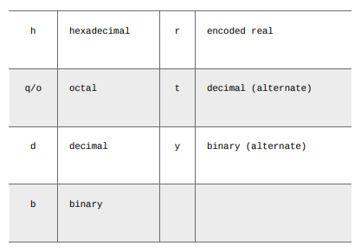
Integer Constants
An integer literal (also known as an integer constant ) is made up of an optional leading sign, one or more digits, and an optional radix character that indicates the number’s base:
. If Constant doesn’t have a radix, so we assume it’s in decimal format.

Slide 12
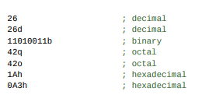
Integer Constants
Here are some integer literals declared with various radixes. Each line contains a comment:
A hexadecimal literal beginning with a letter must have a leading zero to prevent the assembler from interpreting it as an identifier.
Such is the case with the hexadecimal value A3h in the foregoing list, which must be written as 0A3h.

Slide 13
CLASS ACTIVITY
Write down Contents
Of AL,BL & CL
After execution of each instruction
1. MOV AL, 255
2. MOV BL, 10
3. MOV CL, 20
4. ADD AL, 1
5. SUB BL,CL
6. SUB AL,1
7. INC BL
8. INC CL
9. SUB BL,CL

Slide 14
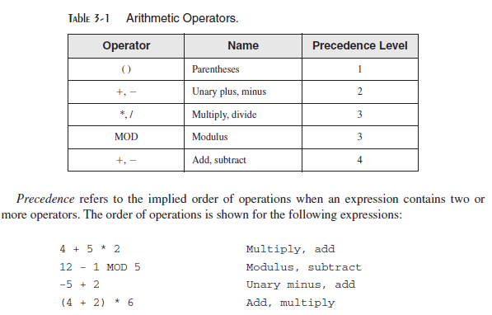
Integer Expressions
An integer expression is a mathematical expression involving integer values and arithmetic operators
The integer expression must evaluate to an integer,
Precedence refers to the implied order of operations when an expression contains two or more operators

Slide 15
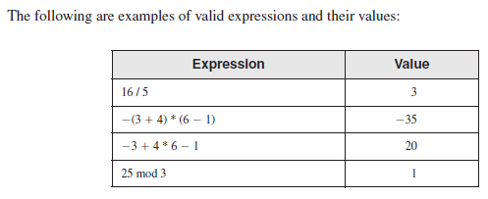
Integer Expressions
Example:

Slide 16
DEFINING DATA
The assembler recognizes a basic set of intrinsic data types, which describe types in terms of their size.
[name] directive initializer [, initializer]...
Initializer: At least one initializer is required in a data definition, even if it is zero.
.data
sum DWORD 0
If you prefer to leave the variable uninitialized (assigned a random value), the ? symbol can be used as the initializer
sum DWORD ?

Slide 17
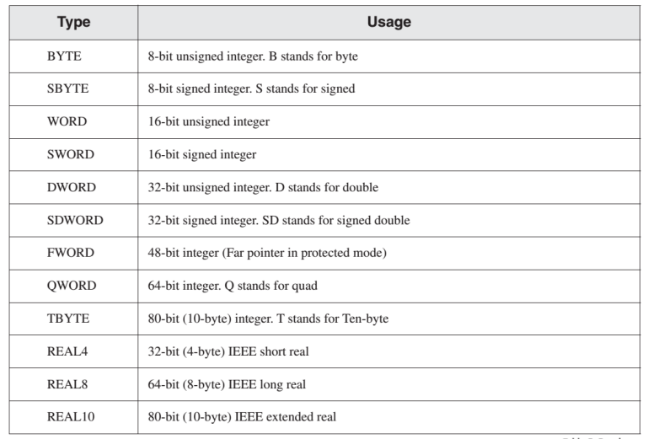
DEFINING DATA

Slide 18
DEFINING DATA
Defining BYTE and SBYTE Data
• Each initializer must fit into 8 bits of storage
value1 BYTE 'A’ ; character constant
value2 BYTE 0 ; smallest unsigned byte
value3 BYTE 255 ; largest unsigned byte
value4 SBYTE -128 ; smallest signed byte
value5 SBYTE +127 ; largest signed byte
value6 BYTE ? ; uninitialized byte

Slide 19
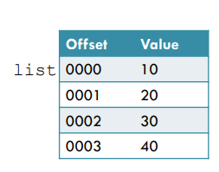
DEFINING DATA
Multiple Initializers
•If multiple initializers are used in the same data definition, its label refers only to the offset of the first initializer.
list BYTE 10,20,30,40
Within a single data definition, its initializers can use different radixes. Character and string literals can be freely mixed. In the following example, list1 and list2 have the same contents:
list1 BYTE 10, 32, 41h, 00100010b
list2 BYTE 0Ah, 20h, 'A', 22h

Slide 20
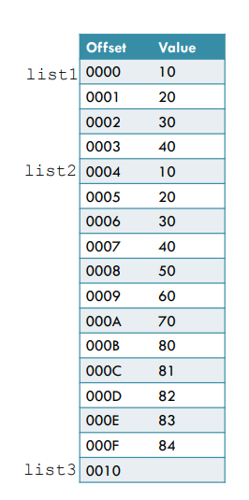
Examples that use multiple initializers:
list1 BYTE 10,20,30,40
list2 BYTE 10,20,30,40
BYTE 50,60,70,80
BYTE 81,82,83,84
list3 BYTE ?,32,41h,00100010b
list4 BYTE 0Ah,20h,‘A’,22h

Slide 21
Defining Strings:
The most common type of string ends with a null byte (containing 0), called a null-terminated string.
greeting1 BYTE "Good afternoon",0
greeting2 BYTE 'Good night',0
•Each character uses a byte of storage.
•The rule that byte values must be separated by commas does not apply on strings.

Slide 22
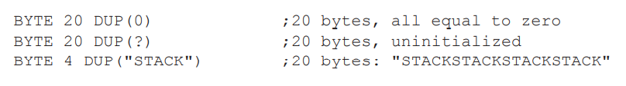
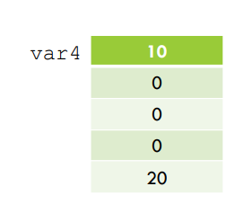
DUP OPERATOR
The DUP operator allocates storage for multiple data items, using a integer expression as a counter.
var4 BYTE 10,3 DUP(0), 20

Slide 23




EXERCISE
Define
i. Largest unsigned Value (16-bits)
ii. Smallest Signed Value (16-bits)
iii. Initialized Array of 5 Words.
iv. Un-initialized Array of 5 Words.
Define
i. Largest unsigned Value (32-bits)
ii. Smallest Signed Value (32-bits)
iii. Unsigned Array. (32- bits)
iv. Signed Array . (32-bits)

Slide 24
Real Number
Real number constants are represented as decimal reals or encoded (hexadecimal) reals.
A decimal real contains are optional sign followed by an integer, a decimal point an optional integer that expresses a fraction, and an optional exponent:
[sign] integer. [integer] [exponent]
Following are the syntax for the sign and exponent:
sign { + , - }
exponent E [ { + , - } ] integer
Following are examples of valid number constants:
2.
+3.0
-44.2E+05
26.E5
At least one digit and a decimal point are required.

Slide 25
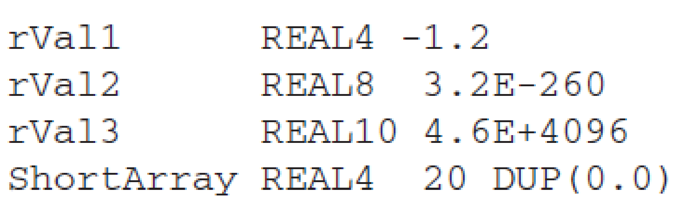
Real Number
REAL4 defines a 4-byte single-precision floating-point variable. REAL8 defines an 8-byte double-precision value, and REAL10 defines a 10-byte extended-precision value. Each requires one or more real constant initializers:
The MASM assembler includes data types such as REAL4 and REAL8, suggesting the values they represent are real numbers. More correctly, the values are floating-point numbers, which have a limited amount of precision and range.

Slide 26
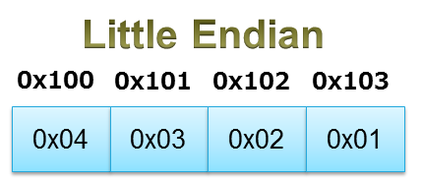
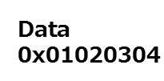
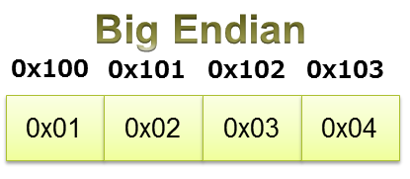
Little and Big Endian

Slide 27
Directive
•A directive is a command embedded in the source code that is recognized and acted upon by the assembler.
• .data
• .code
• .stack
• DWORD

Slide 28
DIRECTIVE VS INSTRUCTION
myVar DWORD 26
DWORD directive tells the assembler to reserve space in the program for a doubleword variable.
mov eax,myVar
The MOV instruction, on the other hand, executes at runtime, copying the contents of myVar to the EAX register.

Slide 29
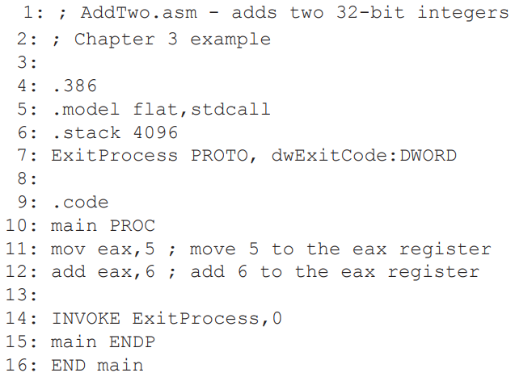
EXAMPLE CODE

Slide 30
EXAMPLE CODE (EXPLANATION)
.386 directive identifies the program as a 32-bit program that can access 32-bit registers and addresses.
.model flat, stdcall selects the programs memory model, and identifies the calling convention.
The stdcall keyword tells the assembler how to manage the runtime stack when procedures are called.
It is a calling convention, that is a scheme for how subroutines receive parameters from their caller and how they return a result.

Slide 31
EXAMPLE CODE (EXPLANATION)
.stack 4096 sets aside 4096 bytes of storage for the runtime stack.
It tells the assembler how many bytes of memory to reserve for the program’s runtime stack.
Stack are used :
to hold passed parameters
to hold the address of the code that called the function. The CPU uses this address to return when the function call finishes, back to the spot where the function was called.
Stack can hold local variables.

Slide 32
EXAMPLE CODE (EXPLANATION)
When your program is ready to finish, it calls ExitProcess that returns an integer that tells the operating system that your program worked just fine.
The ENDP directive marks the end of a procedure.
Our program had a procedure named main, so the endp must use the same name.
Line 16 uses the END directive to mark the last line to be assembled (end of program), and it identifies the program entry point (main).
If you add any more lines to a program after the END directive, they will be ignored by the assembler.

Slide 33
REVIEW QUESTIONS
What is the Purpose of TITLE Directive?
It marks entire line as comment.
Example 🡪 TITLE Add and Subtract (AddSub.asm)
What is the Purpose of INCLUDE Directive?
Copies necessary definitions and setup information from text file.
Example 🡪 INCLUDE irvine32.inc

Slide 34


